Slide 1
Traffic-Aware Power-Gating Scheme for Network-On-Chip Routers
Nasim Nasirian∗, Reza Soosahabi†, Magdy Bayoumi∗
2016

Slide 2
OUTLINE
Context and Motivation
Proposed Design
Experimental results
Conclusion

Slide 3
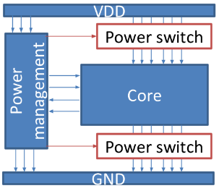
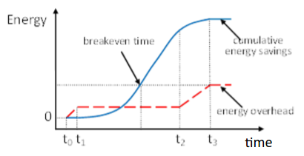
Context and motivation
Network-on-chip
Power gating
Power reduction
Delay, power overhead
Traffic-aware
- Traffic inter-arrival times estimation
- Decision
Notes:
Traffic-aware la 1 thiet ke dieu khien tin hieu power-gating dua tren su uoc luong khoang thoi gian giua cac lan den
Hinh tren la bieu do cac khoang chinh trong 1 chu ki power-gating

Slide 4
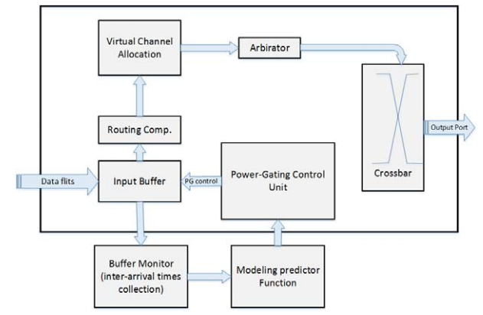
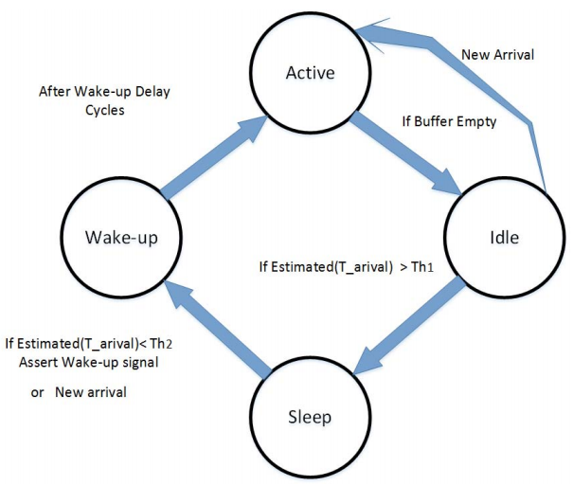
Propose design
Router Architecture
State Diagram of Buffers
Notes:
- Cap phat kinh ao
Bo phan xu
Th1: T breakeven
Th2: T weakup delay

Slide 5
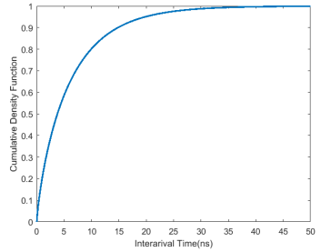
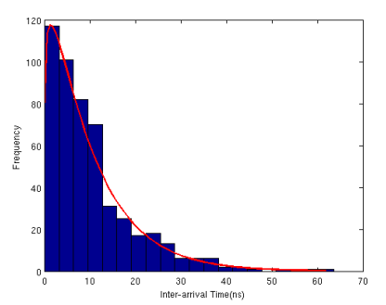
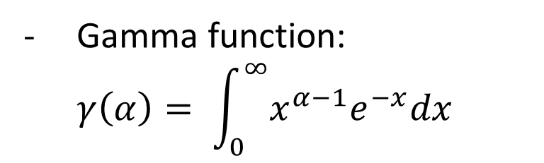
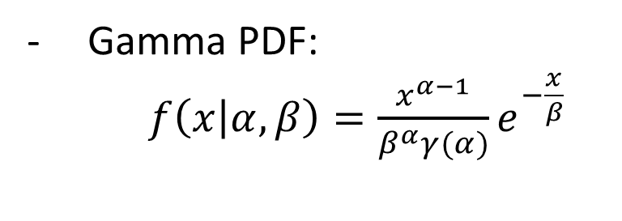
Inter-arrivel times estimation
The inter-arrivel time denoted by random variable X follows the Gamma distribution
Gamma function:
$$γ\left(α\right)= \int_{0}^{∞}{x^{α−1}e^{−x}dx}$$
Gamma PDF:
$f\left(x | α, β\right)=\frac{x^{α−1}}{β^{α}γ(α)}e^{−\frac{x}{β}}$

Slide 6

Result
Training data (NOXIM):
α = 1.148, β = 7.73529 in 4 × 4 network
α = 0.87, β = 7.236 in 8 × 8 network
Hardware implementation
(Synopsys 45nm technology in 500 MHz)
Improving 25% static power consumption
Reducing 35% the average packet latency
Decreasing 41% overhead compare with look-ahead routing approach (Matsutani-2008)
Area increase 15%

Slide 7
Thank you for your attention !

